Slide 1
Angular Training
‹#›

Slide 2
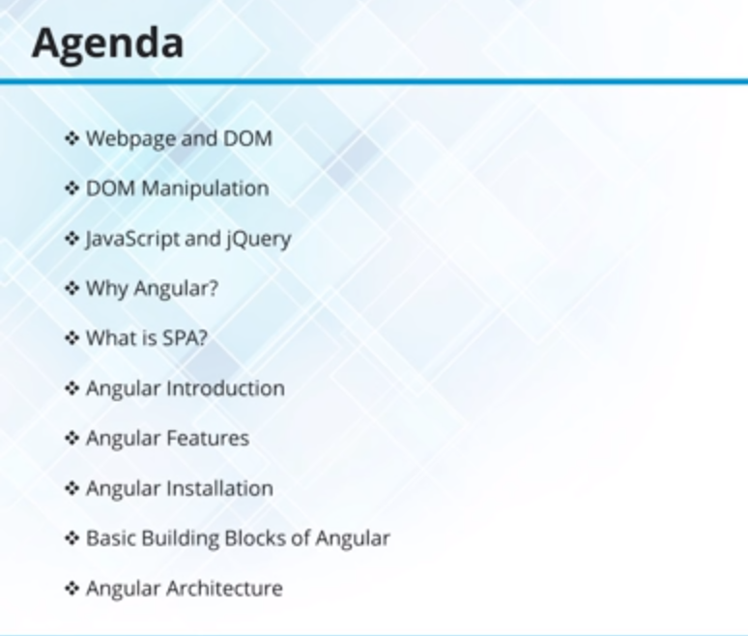

Slide 3
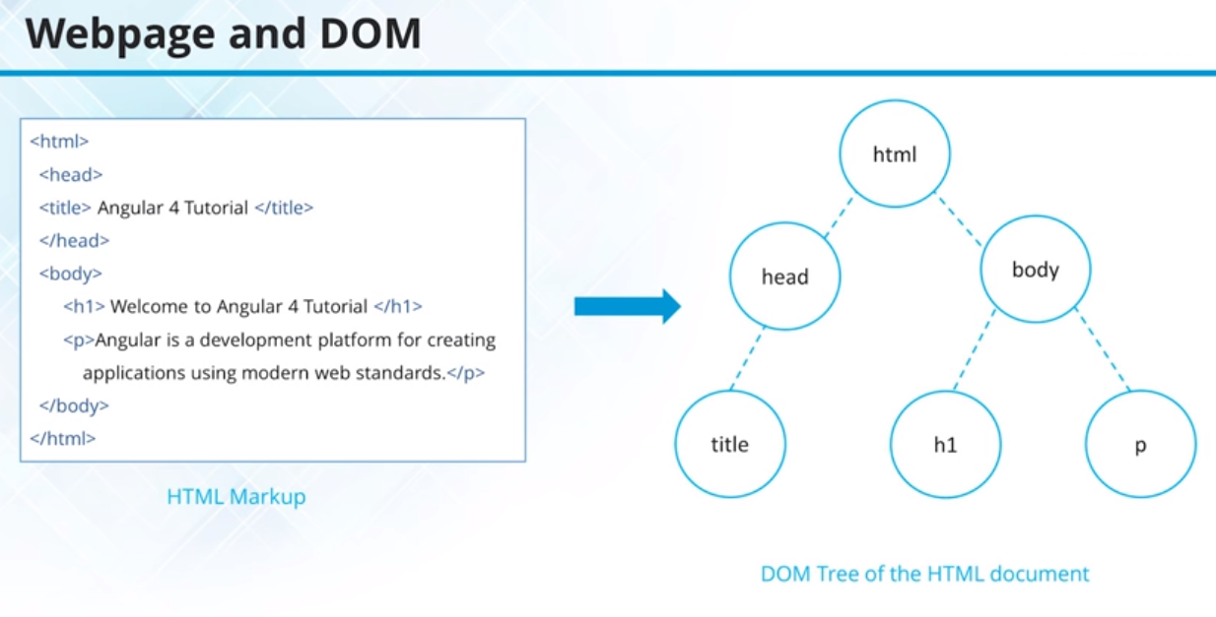

Slide 4
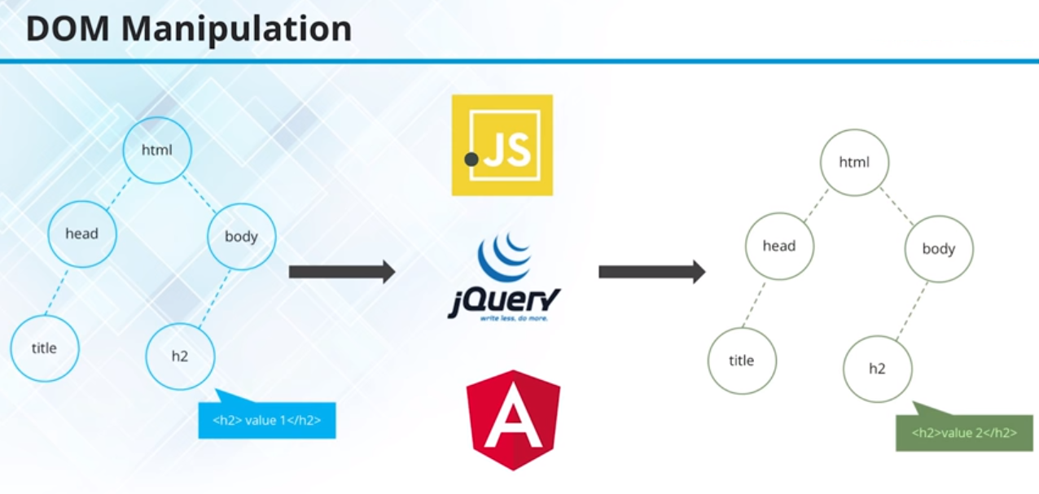

Slide 5
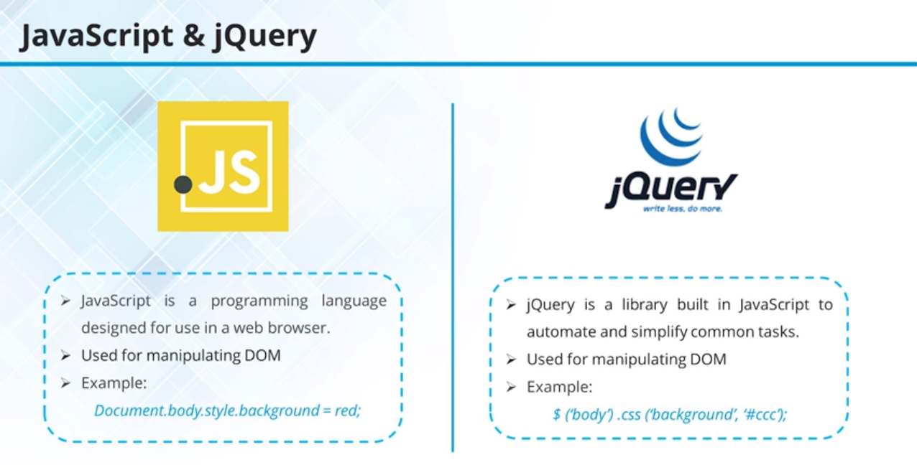

Slide 6
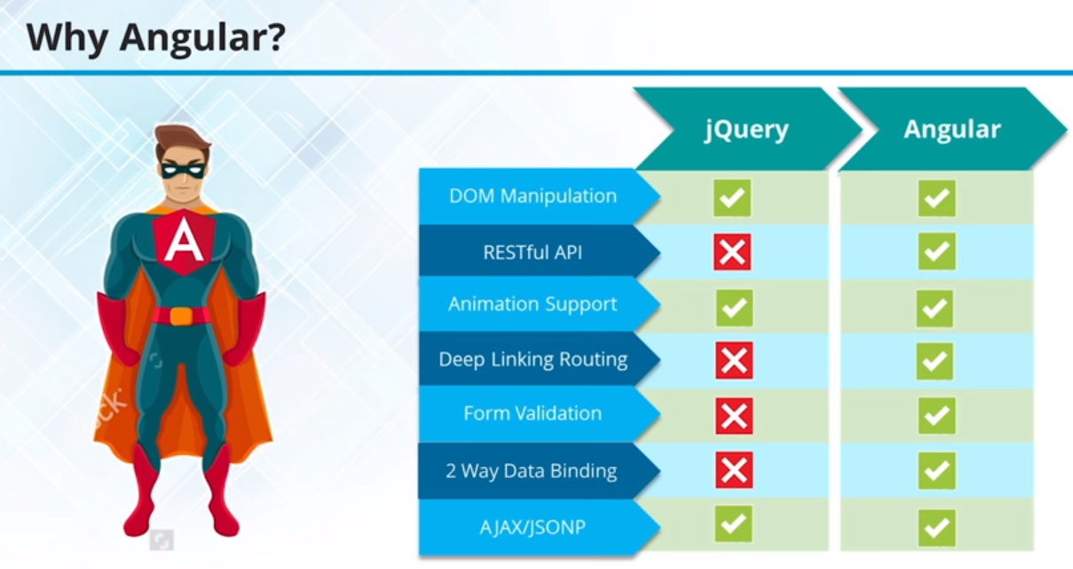

Slide 7
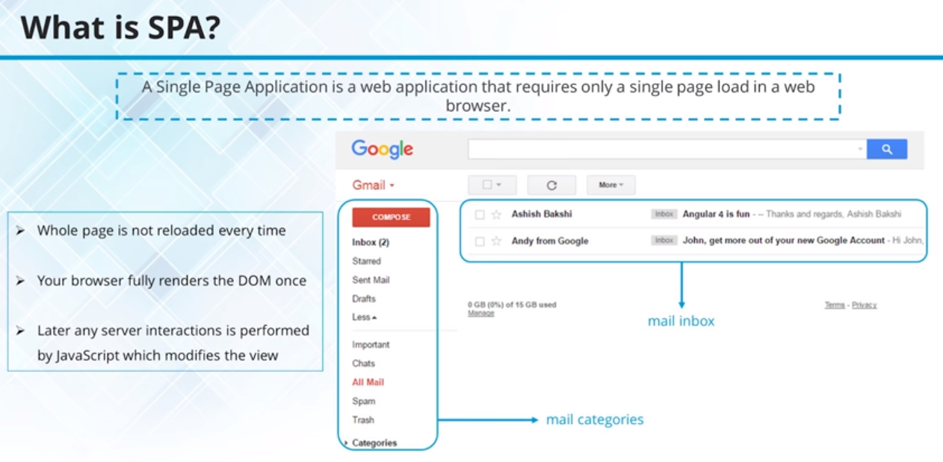

Slide 8
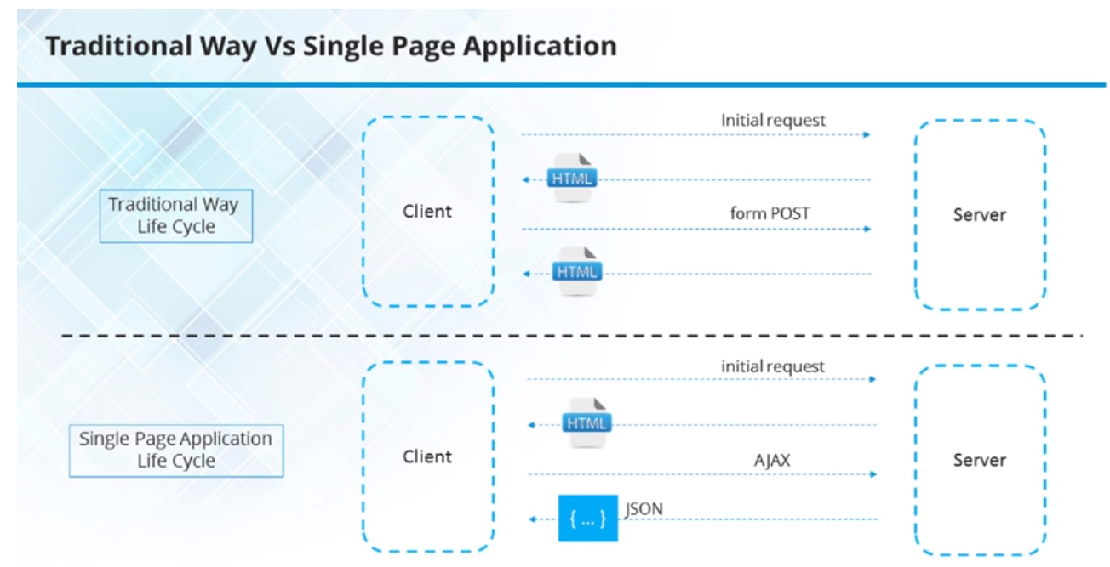

Slide 9
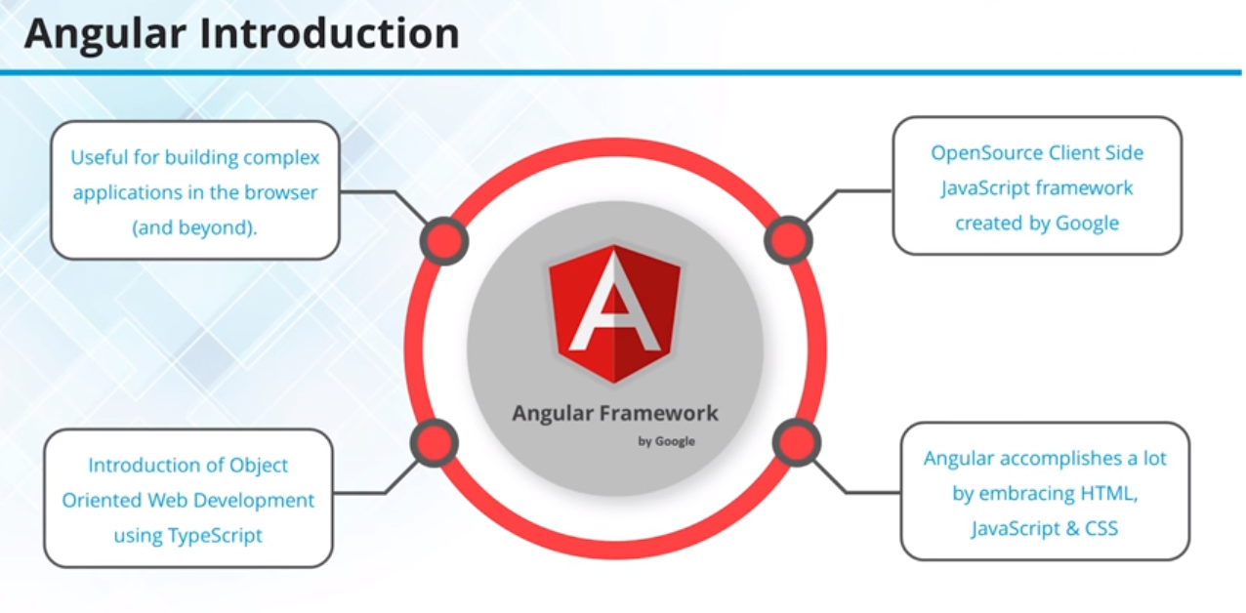

Slide 10
Angular Introduction
Original name was AngularJS released in 2012..
Angular 2.0 was released on September 14, 2016.
Angular 2 is built in TypeScript
Official collaboration between Microsoft and Google
JavaScript-like language
Superset of EcmaScript6
Improvements over ES6
Types
Classes
Annotations
Imports
Language Utilities (e.g. destructuring)
Angular 4 was released on March 23, 2017, Angular 4 is backward compatible with Angular 2.
Angular 4.3 is a minor release, meaning that it contains no breaking changes and that it is a drop-in replacement for 4.x.x.
Features in version 4.3
Introducing HttpClient, a smaller, easier to use, and more powerful library for making HTTP Requests.
New router life cycle events for Guards and Resolvers. Four new events: GuardsCheckStart, GuardsCheckEnd, ResolveStart, ResolveEnd join the existing set of life cycle event such as NavigationStart.
Conditionally disable animations.

Slide 11
Angular Introduction
Angular 5 was released on November 1, 2017
Angular 6 was released on May 4, 2018.
Angular 7 was released on October 18, 2018.

Slide 12
Angular Introduction
Angular 8 was released on May 28, 2019.
Differential loading for all application code
Dynamic imports for lazy routes
Web workers
TypeScript 3.4 support
Angular Ivy as an opt-in preview
Generated code that is easier to read and debug at runtime
Faster re-build time
Improved payload size
Improved template type checking
Backwards compatibility

Slide 13
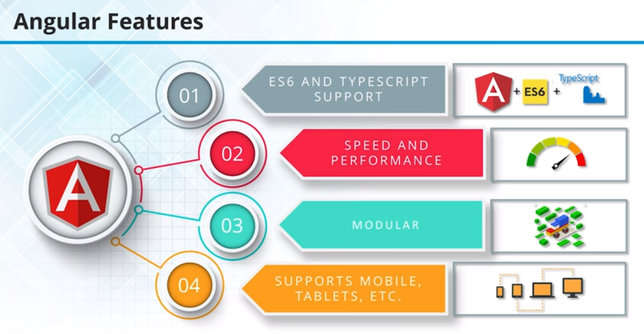

Slide 14
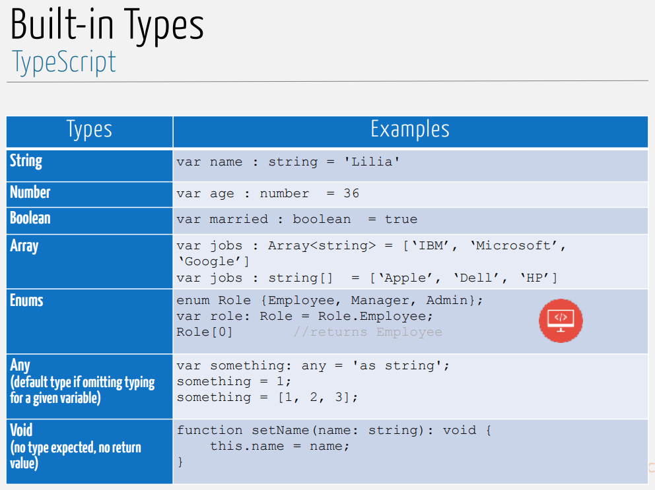
Angular (TypeScript)

Slide 15
TypeScript
In ES5, OO programming was accomplished by using prototype-based objects
In ES6, built-in classes were defined
class Vehicle {}
Classes may have properties, methods and constructors
Properties
Each property can optionally have a type 7 TypeScript
class Person
{
first_name: string;
last_name:
string; age: number;
}

Slide 16
TypeScript
Methods
To call a method of a class, we have to create an instance of this class, with the new keyword
class Person {
first_name: string;
last_name: string;
age: number;
greet()
{
console.log("Hello ", this.first_name);
}
ageInYears(years: number): number {
return this.age + years;
}
}
If the methods don’t declare an explicit return type and return a value, it’s assumed to be any

Slide 17
TypeScript
Methods
To invoke a method:
// declare a variable of type Person
var p: Person;
// instantiate a new Person instance
p = new Person();
// give it a first_name
p.first_name = 'Felipe';
// call the greet method
p.greet();
// how old will you be in 12 years?
p.ageInYears(12);

Slide 18


Slide 19
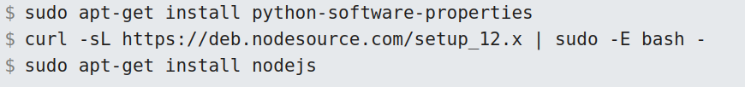
Angular Installation
Step 1 – Install Node.js
Step 2 – Install Angular/CLI

Slide 20
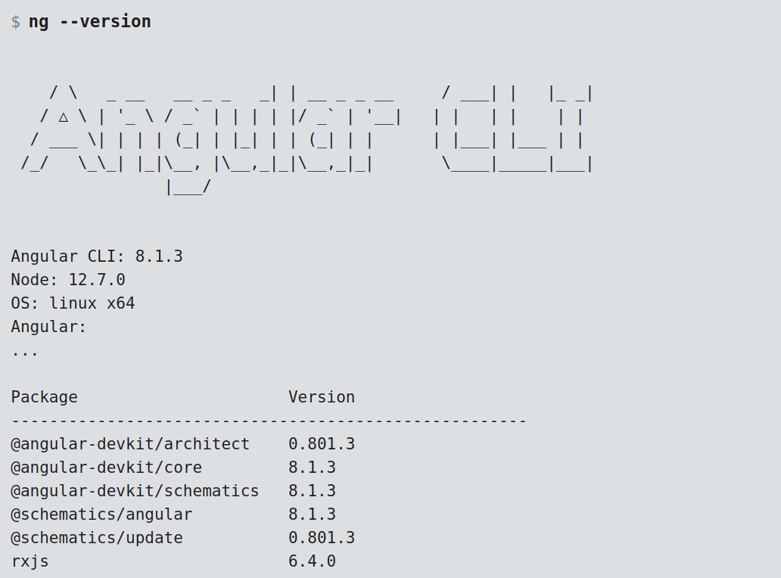
Angular Installation

Slide 21
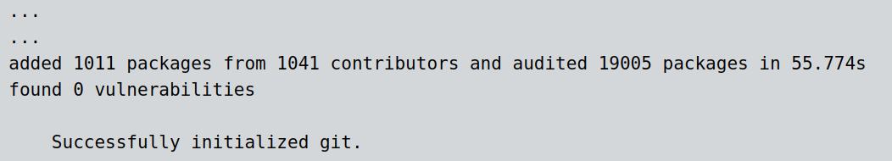
Angular Application
Step 3- Create New Angular Application
Output

Slide 22
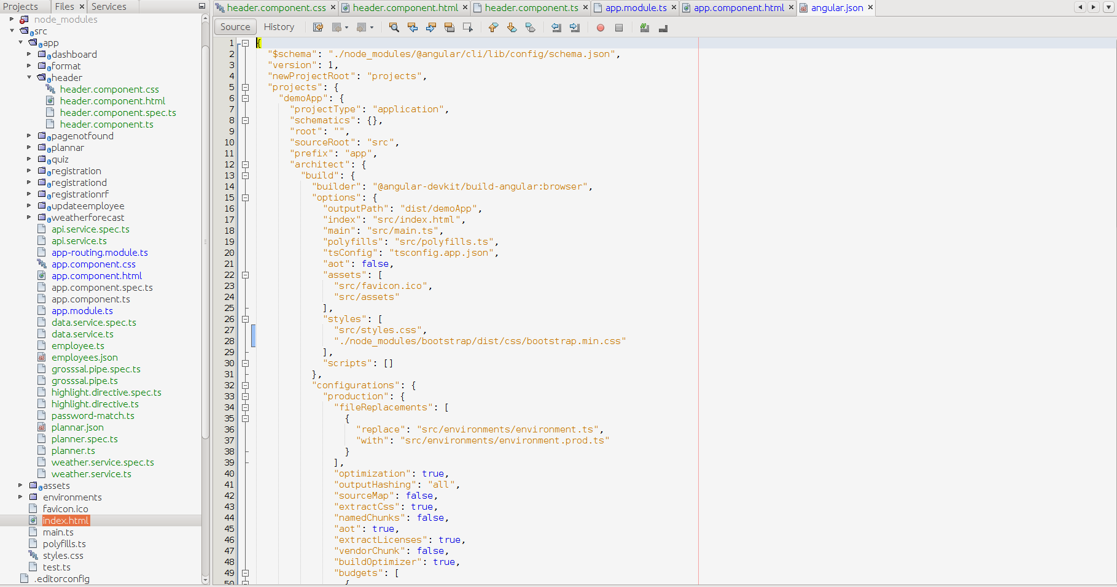
angular.json
$ npm install bootstrap --save

Slide 23
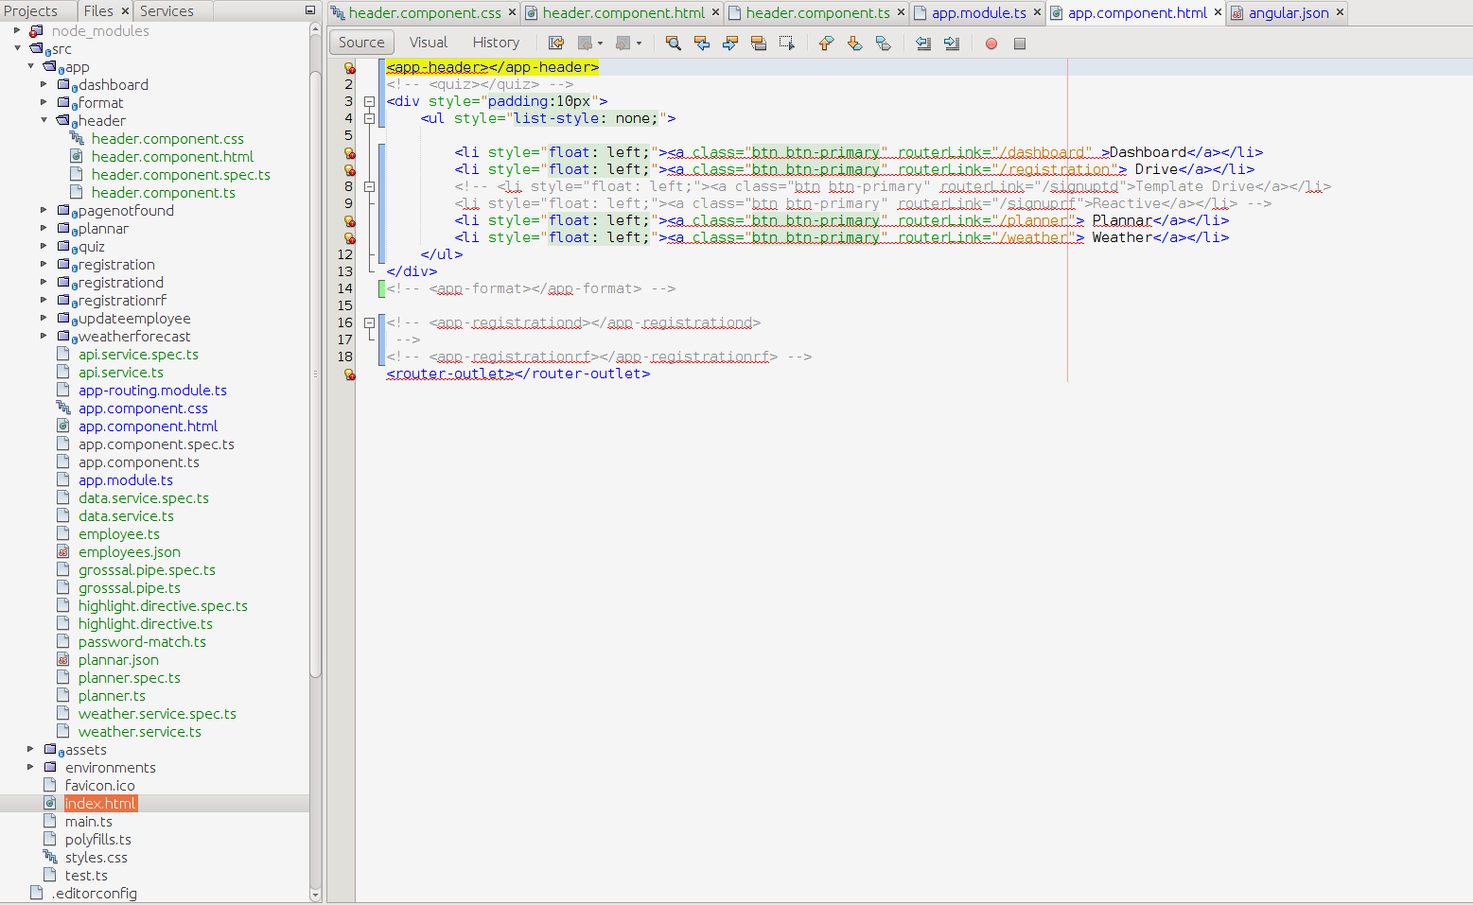
app.component.html

Slide 24
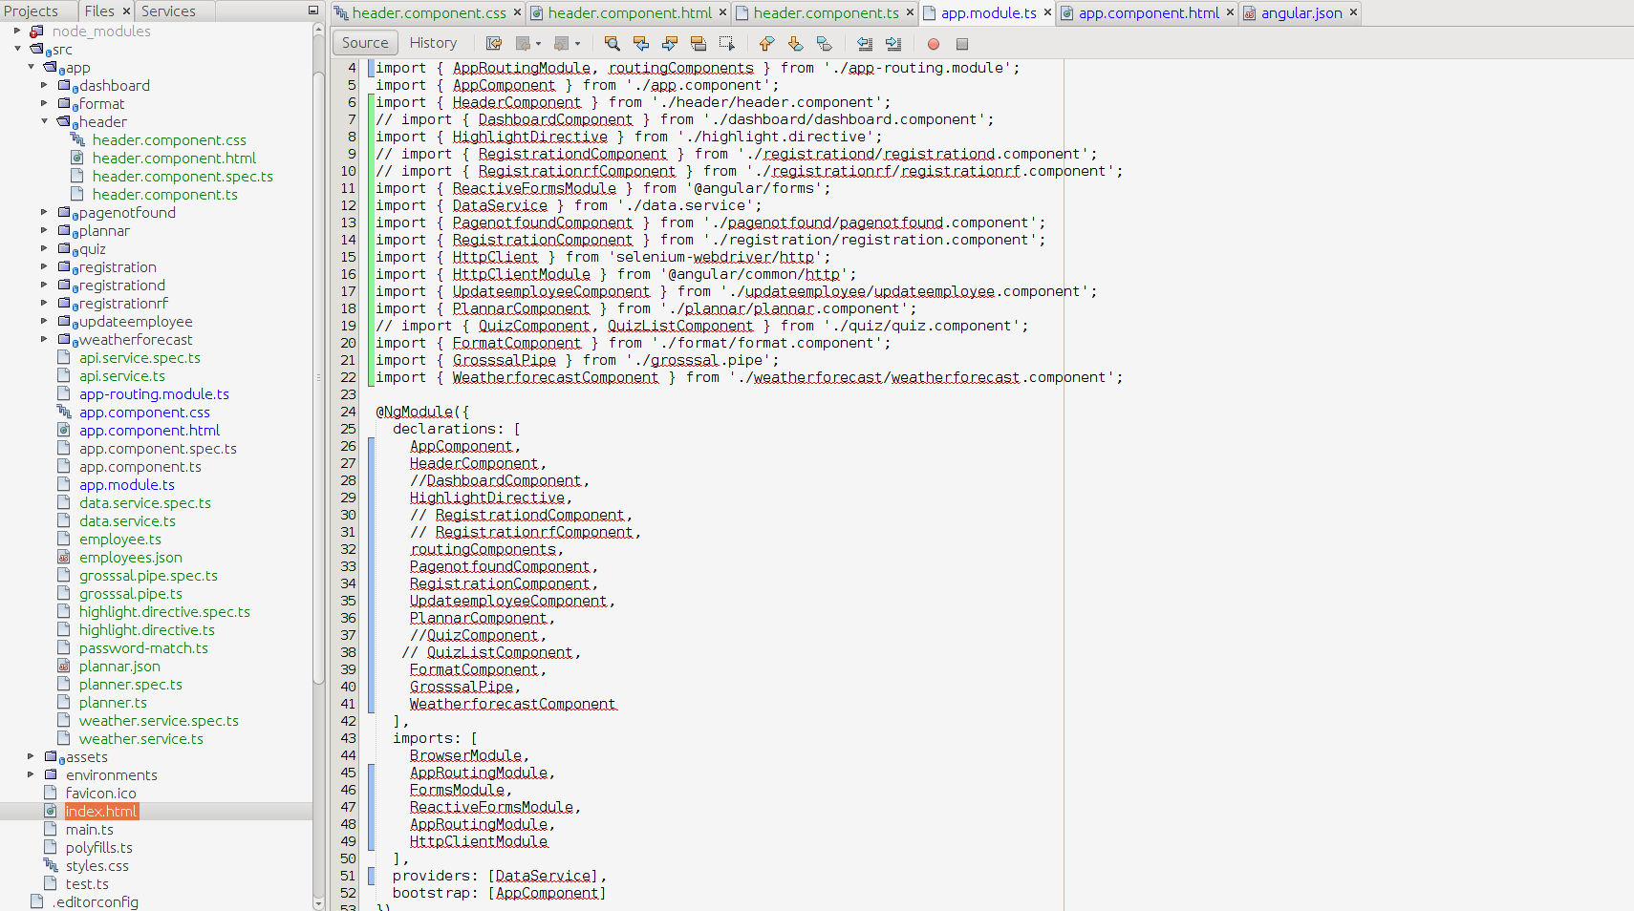
app.module.ts

Slide 25
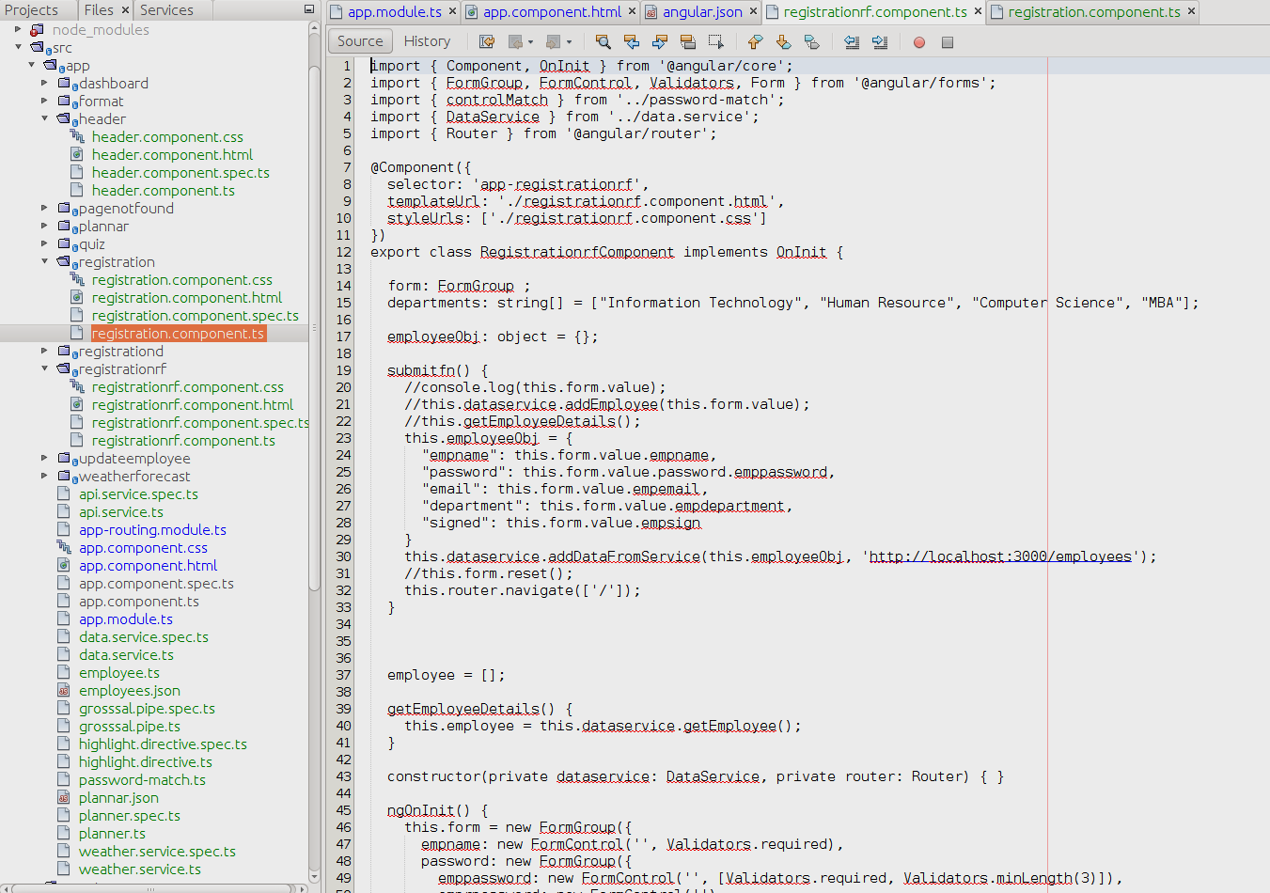
component.ts
$ ng g c registration
ng generate component component_name

Slide 26
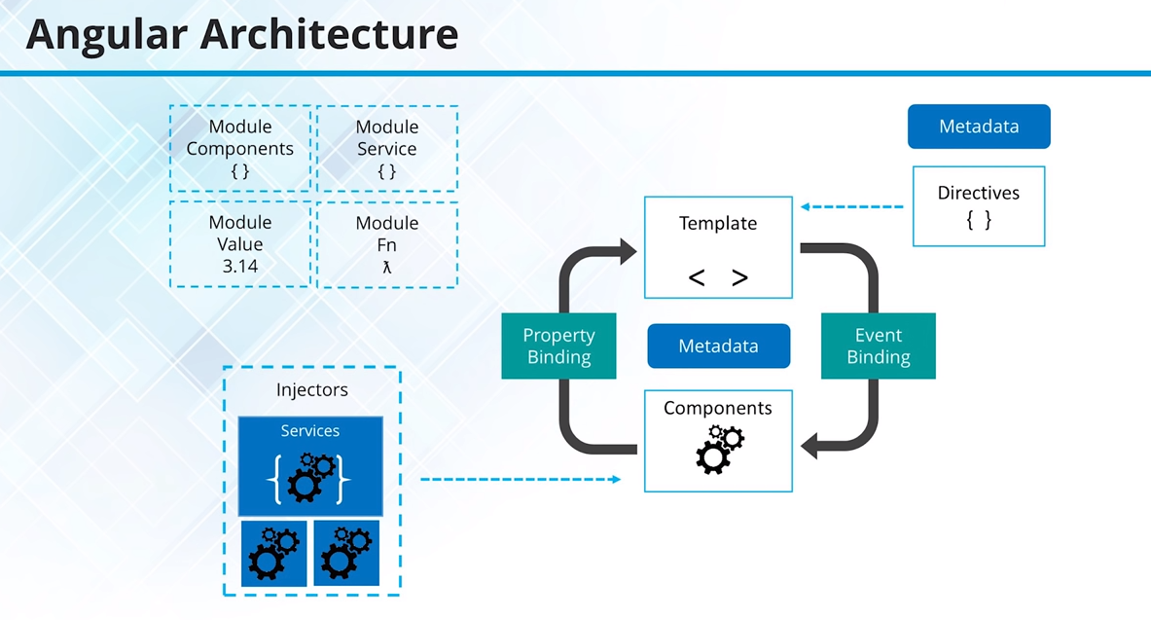

Slide 27
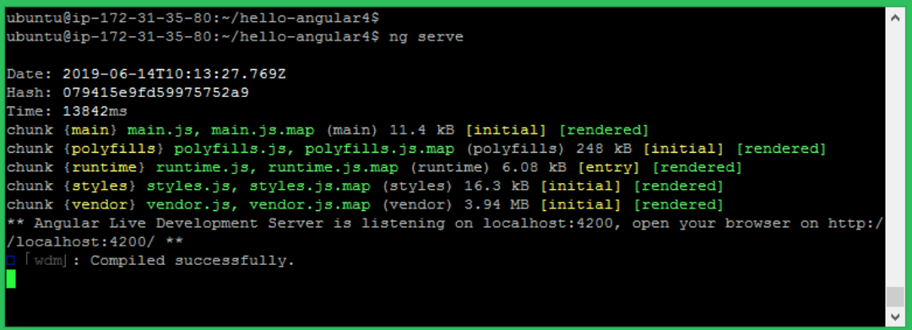
Run Angular Application
Step 4: Server Angular Application
http://localhost:4200/

Slide 28
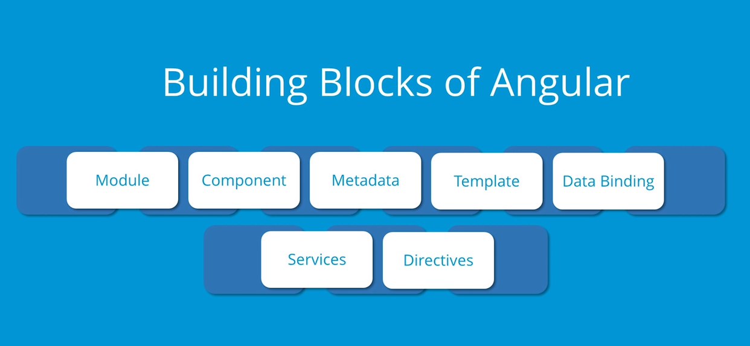

Slide 29
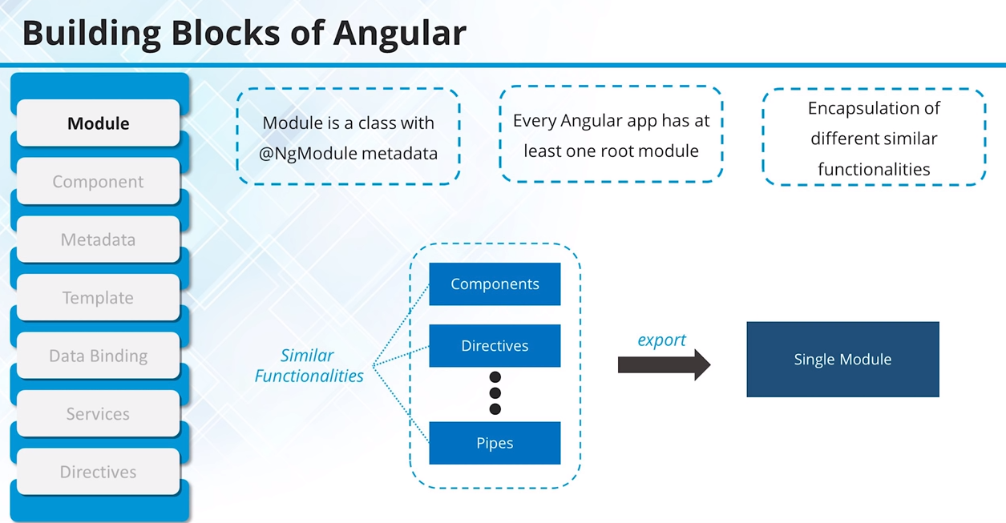

Slide 30
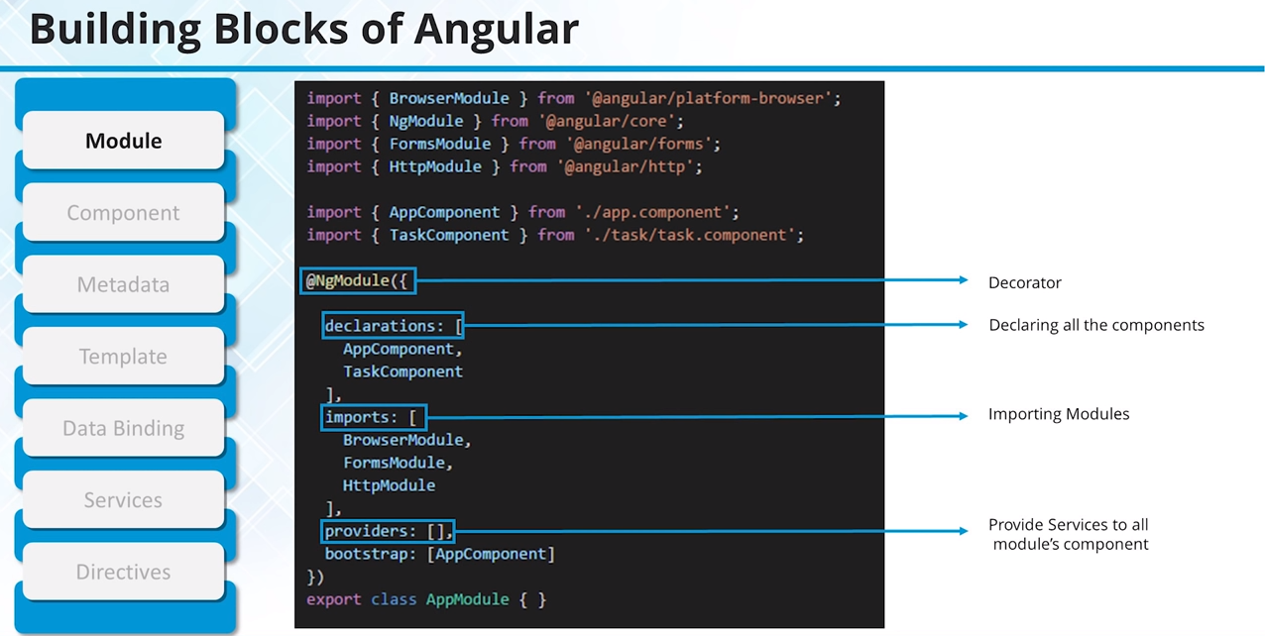

Slide 31
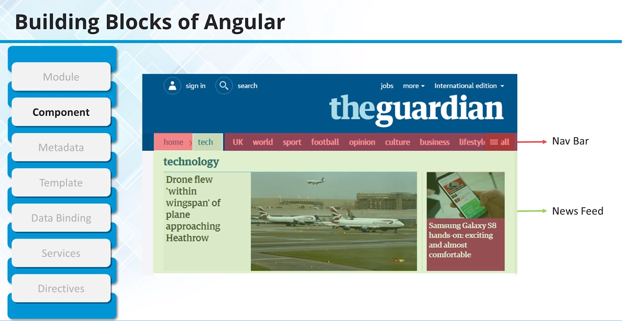

Slide 32
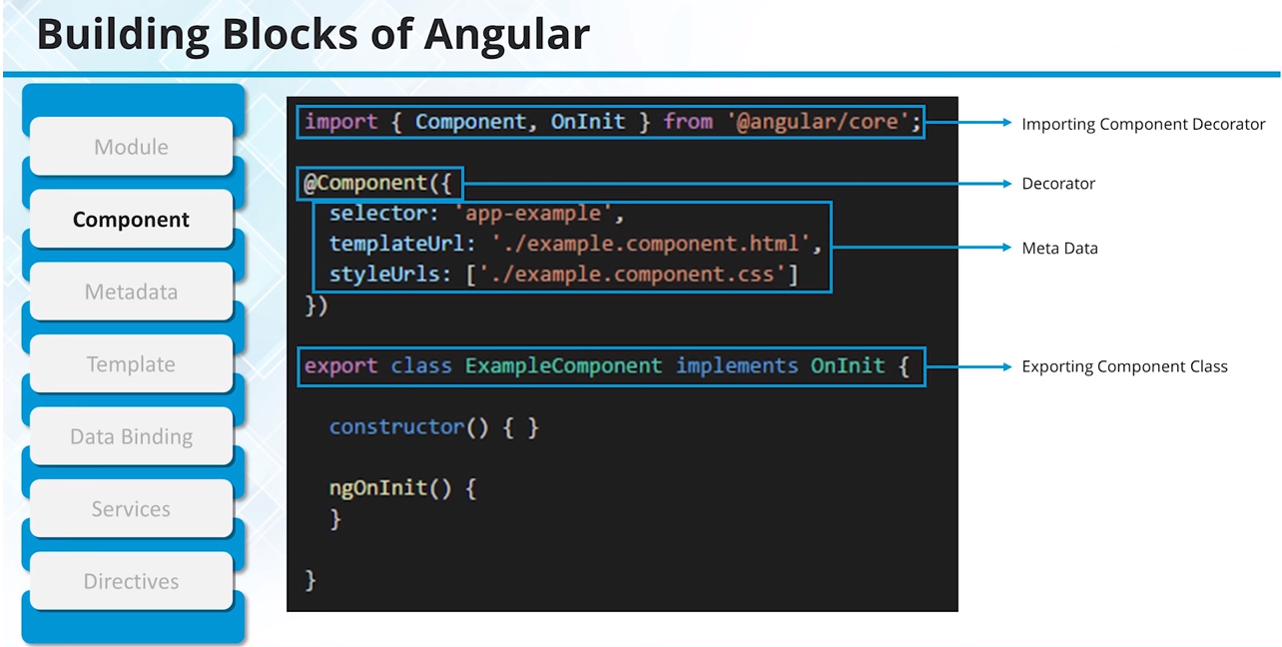

Slide 33
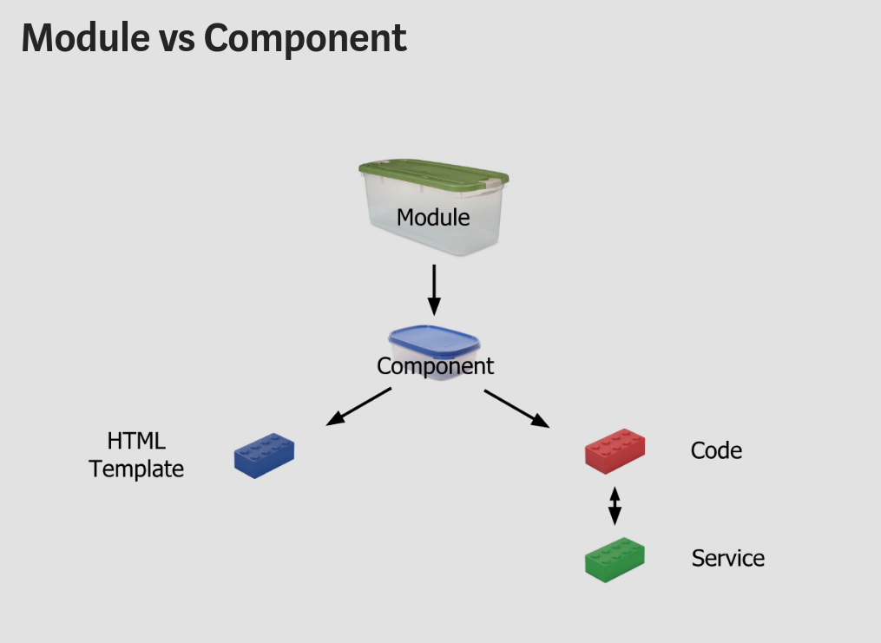

Slide 34
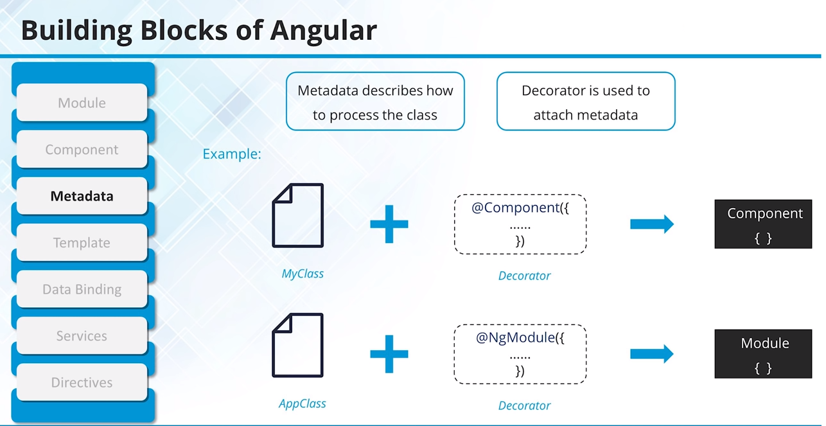

Slide 35
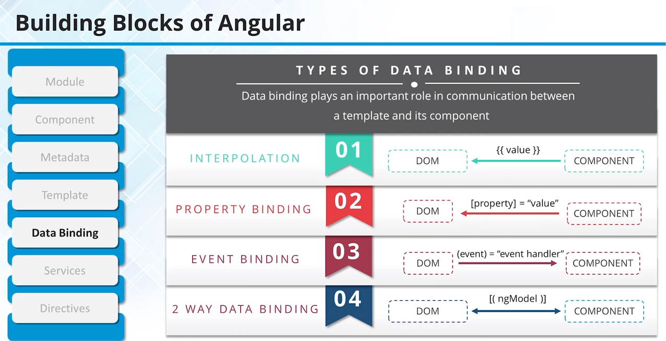

Slide 36
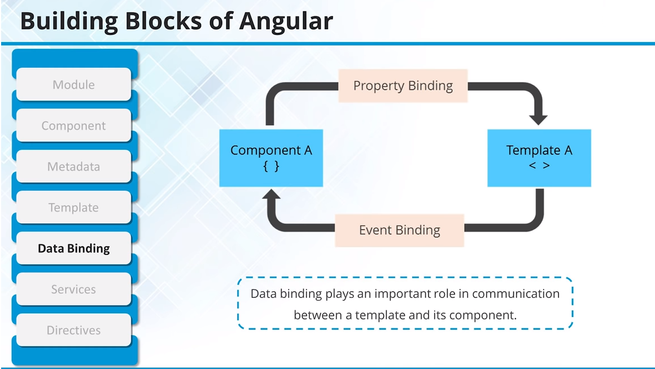

Slide 37
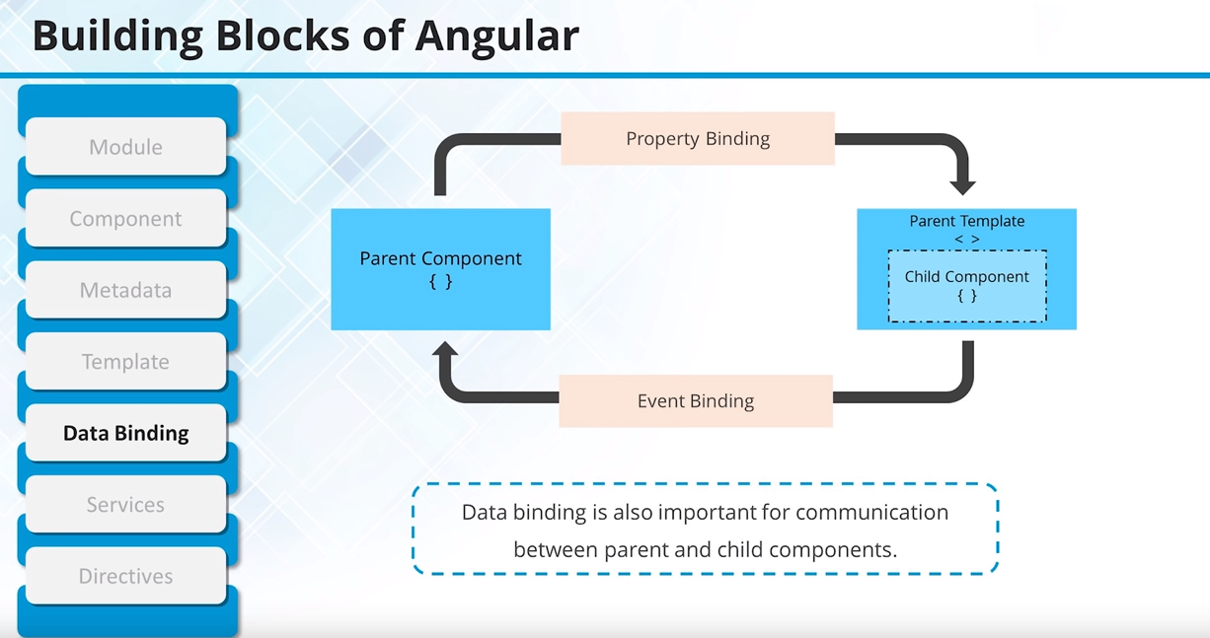

Slide 38
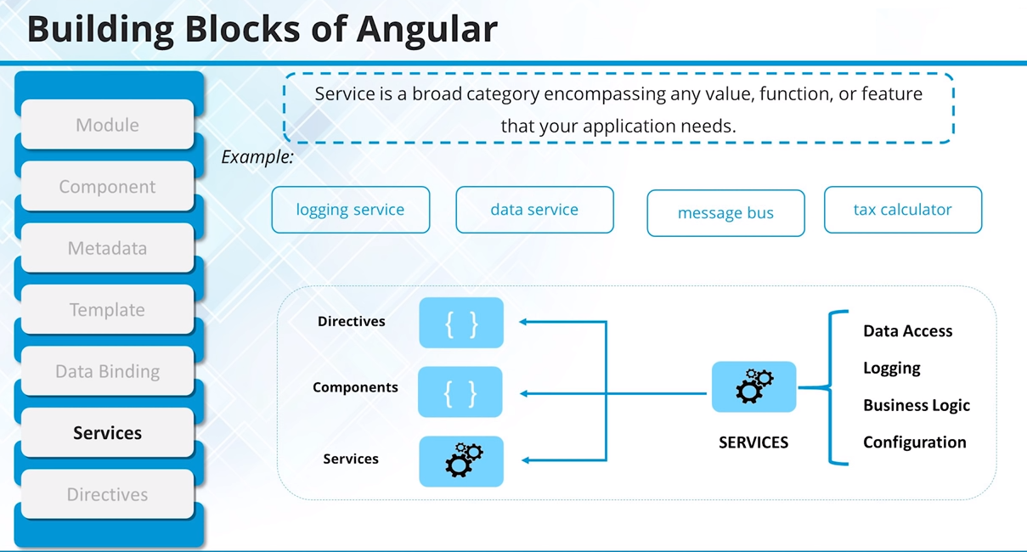
$ ng g s data
ng generate service service_name

Slide 39
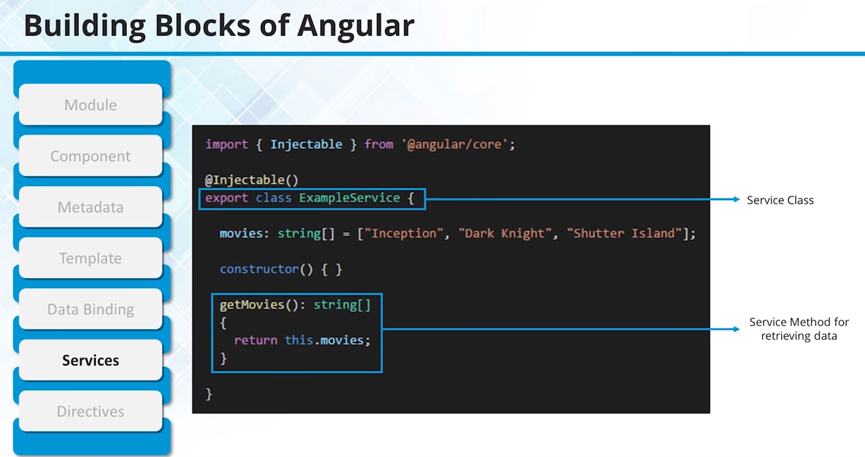

Slide 40
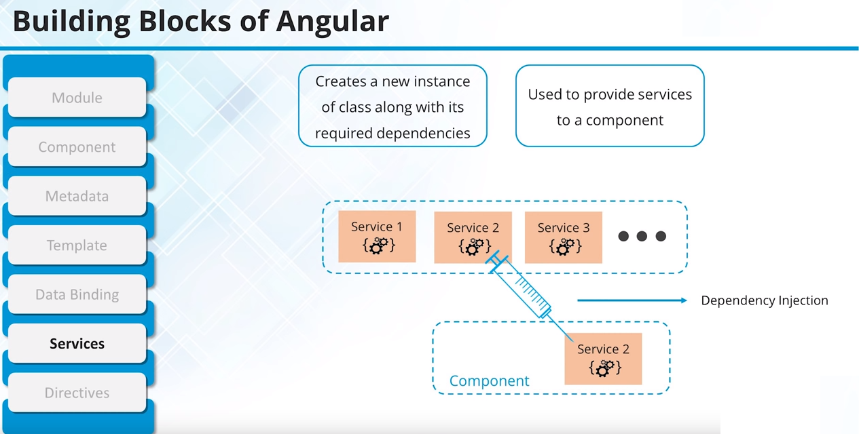

Slide 41
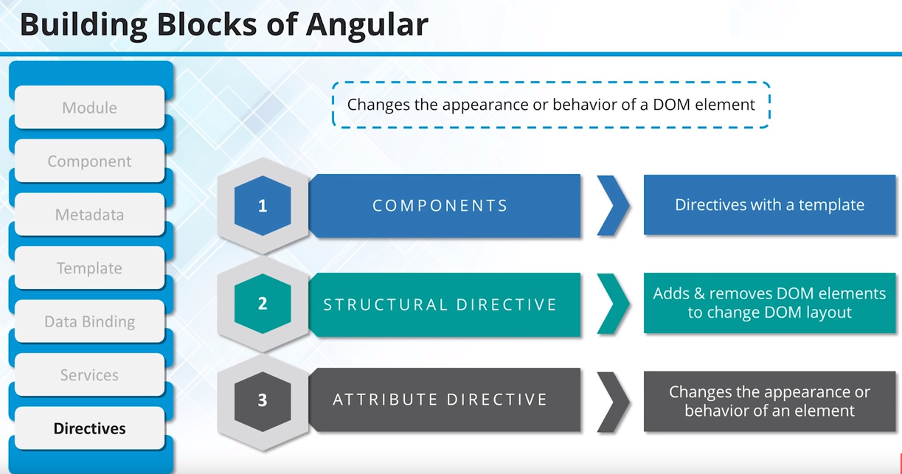
$ ng g d header
ng generate directives component_name

Slide 42
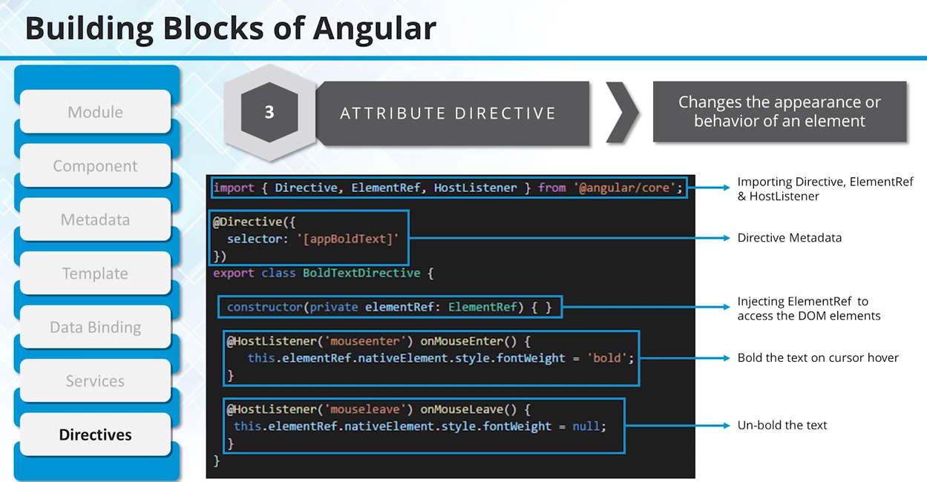

Slide 43
Angular Lifecycle Hooks
In Angular, every component has a life-cycle, a number of different stages it goes through. There are 8 different stages in the component lifecycle. Every stage is called as lifecycle hook event. So, we can use these hook events in different phases of our application to obtain control of the components. Since a component is a TypeScript class, every component must have a constructor method. The constructor of the component class executes, first, before the execution of any other lifecycle hook events. If we need to inject any dependencies into the component, then the constructor is the best place to inject those dependencies. After executing the constructor, Angular executes its lifecycle hook methods in a specific order.

Slide 44
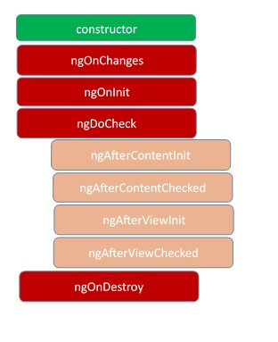

Slide 45
ngOnChanges – This event executes every time when a value of an input control within the component has been changed. Actually, this event is fired first when a value of a bound property has been changed. It always receives a change data map, containing the current and previous value of the bound property wrapped in a SimpleChange.
ngOnInit – This event initializes after Angular first displays the data-bound properties or when the component has been initialized. This event is basically called only after the ngOnChanges()events. This event is mainly used for the initialize data in a component.
ngDoCheck – This event is triggered every time the input properties of a component are checked. We can use this hook method to implement the check with our own logic check. Basically, this method allows us to implement our own custom change detection logic or algorithm for any component.
ngAfterContentInit – This lifecycle method is executed when Angular performs any content projection within the component views. This method executes when all the bindings of the component need to be checked for the first time. This event executes just after the ngDoCheck() method. This method is basically linked with the child component initializations.

Slide 46
ngAfterContentChecked – This lifecycle hook method executes every time the content of the component has been checked by the change detection mechanism of Angular. This method is called after the ngAfterContentInit() method. This method is also called on every subsequent execution of ngDoCheck(). This method is also mainly linked with the child component initializations.
ngAfterViewInit – This lifecycle hook method executes when the component’s view has been fully initialized. This method is initialized after Angular initializes the component’s view and child views. It is called after ngAfterContentChecked(). This lifecycle hook method only applies to components.
ngAfterViewChecked – This method is called after the ngAterViewInit() method. It is executed every time the view of the given component has been checked by the change detection algorithm of Angular. This method executes after every subsequent execution of the ngAfterContentChecked(). This method also executes when any binding of the children directives has been changed. So this method is very useful when the component waits for some value which is coming from its child components.
ngOnDestroy – This method will be executed just before Angular destroys the components. This method is very useful for unsubscribing from the observables and detaching the event handlers to avoid memory leaks. Actually, it is called just before the instance of the component is finally destroyed. This method is called just before the component is removed from the DOM.

Slide 47
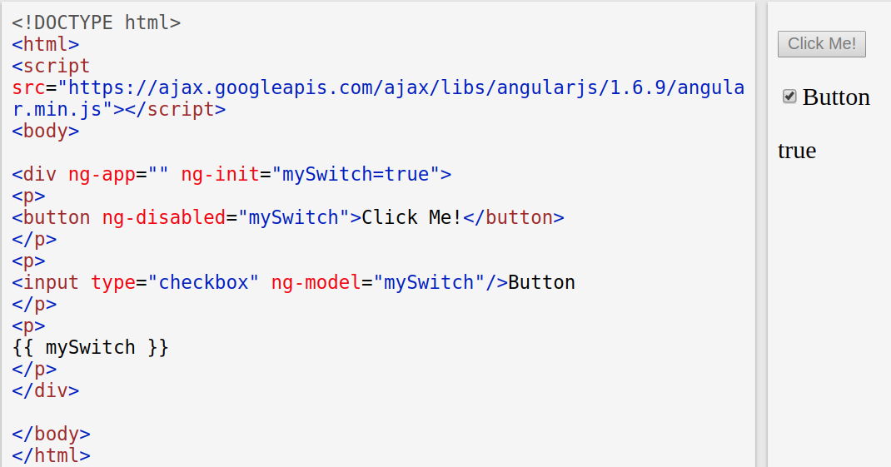
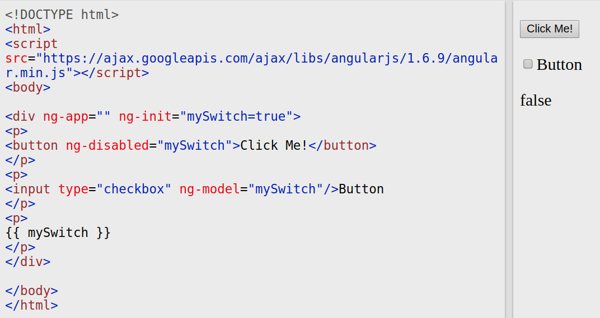
ng-disabled Directive

Slide 48
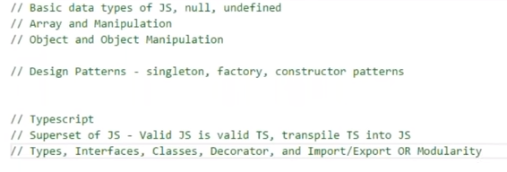

Slide 49
Angular Advantage
Angular presents you not only the tools but also design patterns to build your project in a maintainable way.
It’s JavaScript, but better.
No need to reinvent the bicycle
Components are decoupled
All DOM manipulation happens where it should happen
Testing is at the heart
Angular is mobile and desktop-ready
Angular is actively maintained

